Slide 1
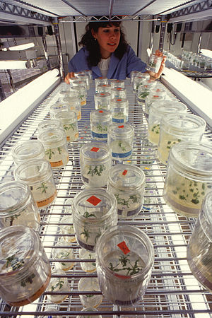
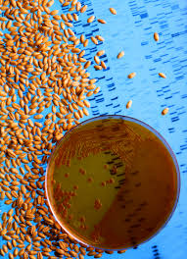
Genetic Engineering
Notes:
Genetic Engineering Presentation
Introduction to Genetic Engineering and Its Applications lesson > TeachEngineering.org
Image sources:
Left-genetically modified peach and apple trees grown in a lab: 2004 Scott Bauer, USDA ARS, Wikimedia Commons
http://commons.wikimedia.org/wiki/File:Apfe-auf-Naehrboden.jpg
Right-wheat seeds treated with bacteria to make them immune to a fungal disease: 2001 Jack Dykinga, USDS, Wikimedia Commons http://commons.wikimedia.org/wiki/File:Bacteria_used_to_make_wheat_seeds_nearly_immune_to_wheat_take-all.jpg

Slide 2
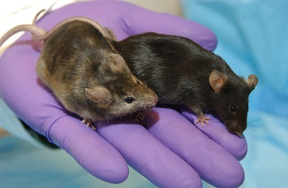
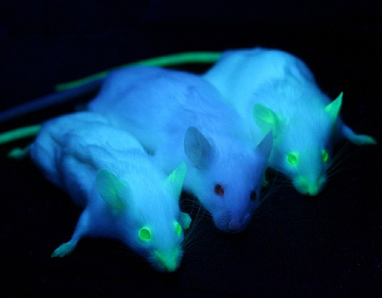
What is the difference between the mice in these two groups?
Notes:
(left-purple hands) The mouse on the left is genetically modified so that a gene affecting hair growth has been “knocked out.” The mouse on the right is a normal mouse.
(right-three mice) The middle mouse is a normal mouse, and the other two are genetically modified to express enhanced green fluorescent protein.
Image sources:
Left: 2012 Maggie Bartlett, NHGRI, Wikimedia Commons http://commons.wikimedia.org/wiki/File:Knockout_Mice5006-300.jpg
Right: 2012 Ingrid Moen et al., Wikimedia Commons http://commons.wikimedia.org/wiki/File:GFP_Mice_01.jpg

Slide 3
What is genetic engineering?
Genetic engineering is the direct modification of an organism’s genome, which is the list of specific traits (genes) stored in the DNA.
Changing the genome enables engineers to give desirable properties to different organisms.
Organisms created by genetic engineering are called genetically modified organisms (GMOs).
Notes:
Image source: 2013 http://pixabay.com/en/dna-biology-medicine-gene-163466/ (public domain)

Slide 4
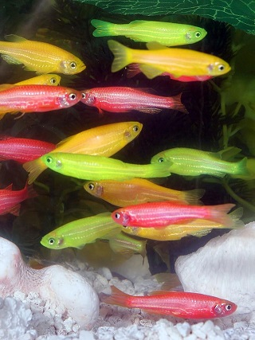
History of GMO Development
1973: created first genetically modified bacteria
1974: created GM mice
1982: first commercial development of GMOs (insulin-producing bacteria)
1994: began to sell genetically modified food
2003: began to sell GMOs as pets (Glofish)
Notes:
Image source: 2007 Hoffmeier, Wikimedia Commons http://commons.wikimedia.org/wiki/File:GloFish.jpg

Slide 5
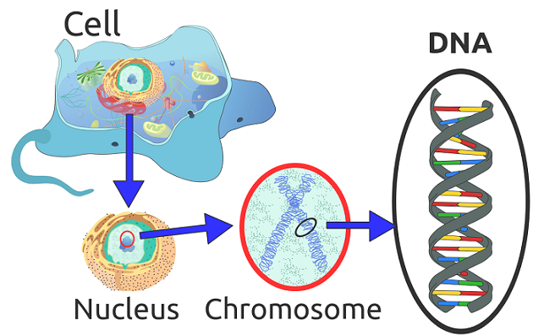
What is the GMO process?
All genetic changes affect the protein synthesis of the organism.
By changing which proteins are produced, genetic engineers can affect the overall traits of the organism.
Genetic modification can be completed by a number of different methods:
Inserting new genetic material randomly or in targeted locations
Direct replacement of genes (recombination)
Removal of genes
Mutation of existing genes
Notes:
Image source: 2012 Radio89, Wikimedia Commons http://commons.wikimedia.org/wiki/File:Eukaryote_DNA-en.svg

Slide 6
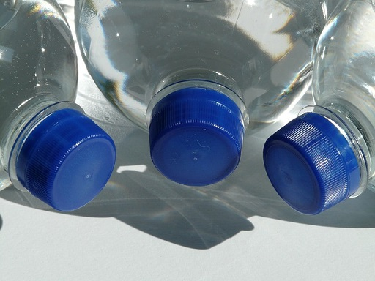
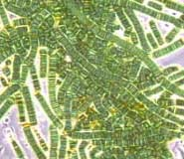
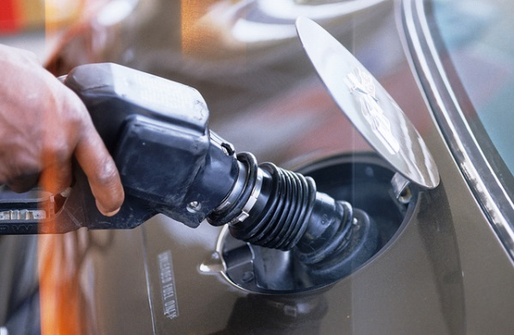
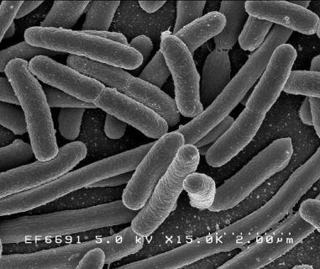
GMO Bacteria
Bacteria are the most common GMOs because their simple structure permits easy manipulation of their DNA.
One of the most interesting uses for genetically modified bacteria is the production of hydrocarbons (plastics and fuels) usually only found in fossil fuels.
Cyanobacteria have been modified to produce plastic (polyethylene) and fuel (butanol) as byproducts of photosynthesis
E. Coli bacteria have been modified to produce diesel fuel
Notes:
Image sources:
Top left-bluegreen algae: 2006 Tim Vickers, Wikimedia Commons http://commons.wikimedia.org/wiki/File:Bluegreen_algae.jpg
Lower left: 2005 Rocky Mountain Laboratories, NIAID, NIH, Wikimedia Commons http://commons.wikimedia.org/wiki/File:EscherichiaColi_NIAID.jpg
Top right: 2012 http://pixabay.com/en/bottles-plastic-bottle-bottle-60474/ (public domain)
Lower right: Wisconsin Department of Natural Resources https://www.flickr.com/photos/widnr/6588204605/ (creative commons license)

Slide 7
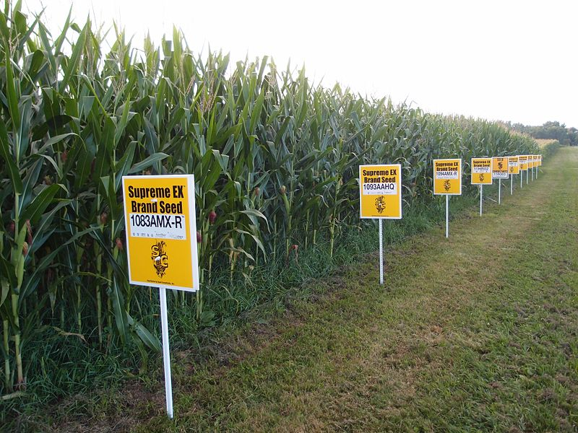
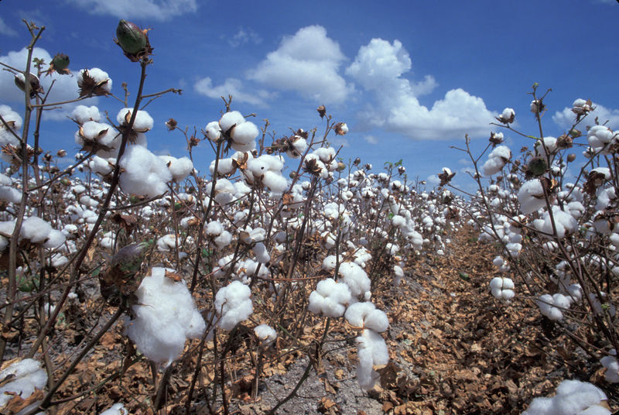
Engineering Plants
How might genetic engineering modify plants to solve everyday problems?
(Consider world hunger, weather problems, insecticide pollution…)
Notes:
Image sources:
Left-GMO corn: 2013 Lindsay Eyink, Wikimedia Commons
http://commons.wikimedia.org/wiki/File:GMO_corn_Yellow_Springs,_Ohio.jpg
Right-GMO cotton: 2004 von David Nance, U.S. Department of Agriculture http://commons.wikimedia.org/wiki/File:Feld_mit_reifer_Baumwolle.jpeg

Slide 8
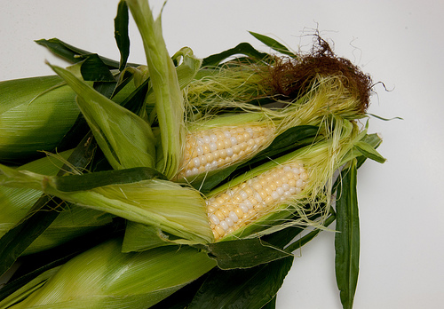
Genetically Modified Crops
GMO crop production in the US (2010):
93% of soybeans
93% of cotton
86% of corn
95% of sugar beets
Example:
One common modified crop is Bt-corn.
A gene from the Bt bacteria is added so the corn produces a protein that is poisonous to certain insects but not humans.
Notes:
Image source: photofarmer http://brickcruz.blogspot.com/2014/05/lately-there-has-been-lot-of-talk-about.html (creative commons license)

Slide 9
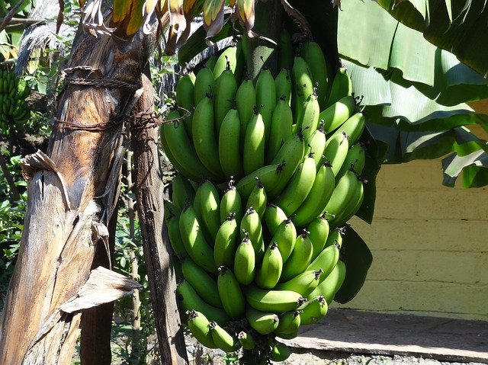
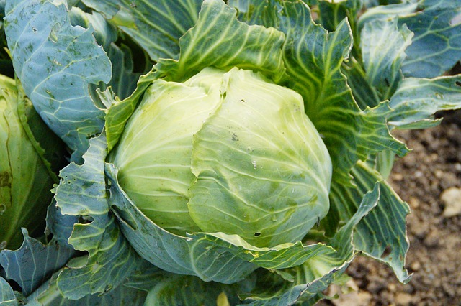
Banana Vaccines
Modified virus injected in sapling tree causes the bananas to contain virus proteins
Venomous Cabbage
Scorpion genes added to the cabbage prevent insects from eating it
Notes:
Image sources:
Top left-bananas: http://pixabay.com/en/bananas-fruit-bunch-banana-tree-241018/ (public domain)
Lower right-cabbage: http://pixabay.com/en/kohl-cabbage-green-vegetables-190821/ (public domain)

Slide 10
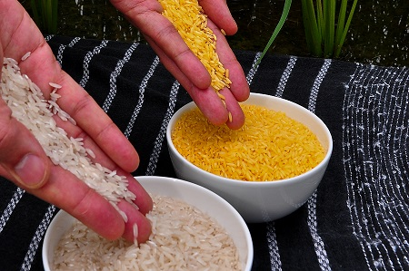
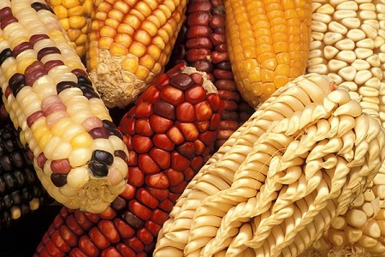
Other Reasons to Genetically Modify Crops
Insect resistant
Herbicide resistant
Drought/freeze resistant
Disease resistant
Higher yield
Faster growth
Improved nutrition
Longer shelf life
Notes:
Golden rice was designed to biosynthesize beta-carotene, a precursor of vitamin A, as a fortified food
Image sources:
Top-golden rice and white rice grains: 2011 (cc-by-2.0), Wikimedia Commons
http://commons.wikimedia.org/wiki/File:Golden_Rice.jpg
Lower-GMO corn: 2013 Keith Weller, USDA, Wikimedia Commons
http://commons.wikimedia.org/wiki/File:Genetically_modified_corn.jpg

Slide 11
Engineering Animals
Could genetic engineering be used to modify any animals to solve problems?

Slide 12
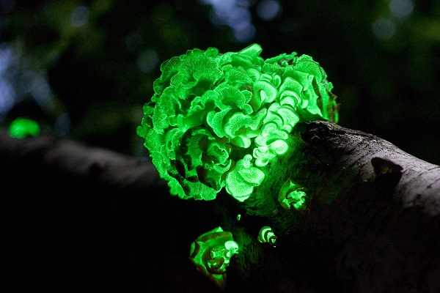
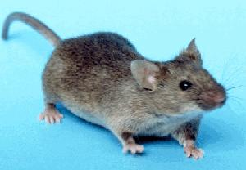
Bioluminescent Animals
Uses:
Protein tracking
Disease detection using bioluminescent imaging (BLI) to identify different types of cells
Novelty pets (Glofish are available now)
Notes:
Image sources:
Upper left-a fungus displaying bioluminescence: 2009, Ylem, Wikimedia Commons
http://commons.wikimedia.org/wiki/File:PanellusStipticusAug12_2009.jpg
Upper right-common house mouse: 2004 NIH, Wikimedia Commons http://commons.wikimedia.org/wiki/File:House_mouse.jpg
Lower-2 mice expressing enhanced green fluorescent protein: 2012 Ingrid Moen et al., Wikimedia Commons http://commons.wikimedia.org/wiki/File:GFP_Mice_01.jpg

Slide 13
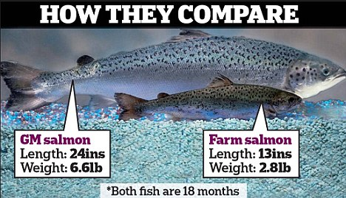
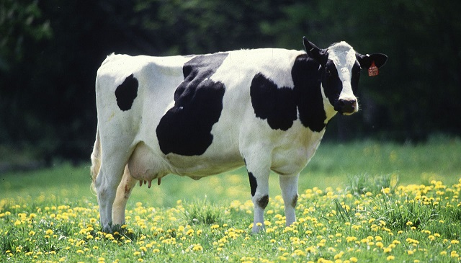
Fast-Growing Salmon
Genes from two other fish cause this salmon to continually produce growth hormones
Less Smelly Cows
Modifying bacteria responsible for methane production in cattle results in 25% less-flatulent cows
Notes:
Image sources:
Upper left: http://www.bloggernews.net/126936/26937 (under Google’s “labeled for resuse”)
Lower right: 2002 Keith Weller, USDA, Wikimedia Commons http://commons.wikimedia.org/wiki/File:Cow_female_black_white.jpg

Slide 14
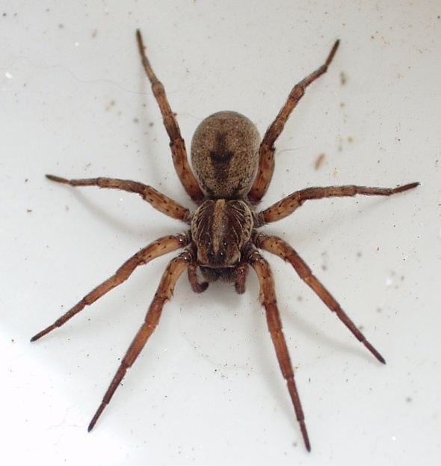
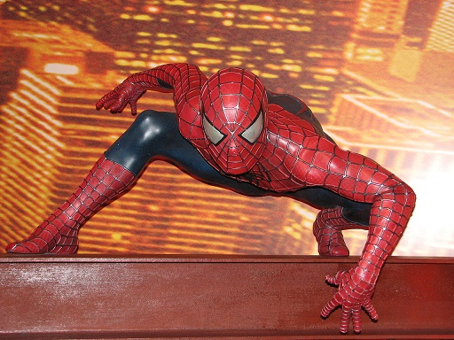
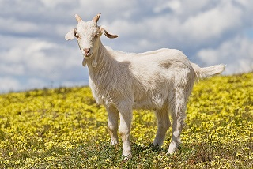
Could Spiderman Be Real?
?
Web-Producing Goats
Spider genes in goats enable the production of spider silk in goat milk
Notes:
Image sources:
Top left-spider: 2012 Patrick Edwin Moran, Wikimedia Commons http://commons.wikimedia.org/wiki/File:Hogna_lenta_18.jpg
Top center: http://pixabay.com/en/black-icon-simple-outline-people-37742/ (public domain)
Top right-spiderman: 2008 Christian Bortes, Wikimedia Commons http://commons.wikimedia.org/wiki/File:Spiderman.JPG
Lower right-goat: 2008 Fir0002/Flagstaffotos, Wikimedia Commons http://commons.wikimedia.org/wiki/File:Domestic_goat_kid_in_capeweed.jpg

Slide 15
GMO Concerns
What are some concerns regarding genetically modified foods and animals?
Risk to human health; unsafe to eat
Harm to the environment and wildlife
Increased pesticide and herbicide use
Farmers’ health
Seed and pollen drift
Creation of herbicide-resistant super weeds
What about genetic engineering in humans?
Nearly 50 countries around the world, including Australia, Japan and all of the countries in the European Union, have enacted significant restrictions or full bans on the production and sale of genetically modified organism food products, and 64 countries now have GMO labeling requirements.
Notes:
Information source: Lancaster Online (August 29, 2014) http://lancasteronline.com/opinion/gmo-food-concerns/article_3c5092ba-2ed0-11e4-ab00-001a4bcf6878.html
Image source (genetically modified peach and apple trees grown in a lab): 2004 Scott Bauer, USDA ARS, Wikimedia Commons
http://commons.wikimedia.org/wiki/File:Apfe-auf-Naehrboden.jpg

Slide 16
Questions?

