Slide 1
What Is a Sensor?
Notes:
What Is a Sensor? Presentation > TeachEngineering.org

Slide 2
What Is a Sensor? Pre-Quiz
How many sensors or senses do humans have? List them.
Describe how any two of the sensors you listed work.
Give examples of sensors in robots that are similar to at least three human senses.

Slide 3
What Is a Sensor? Pre-Quiz Answers
How many sensors or senses do humans have? List them.
Describe how any two of the sensors you listed work.
Give examples of sensors in robots that are similar to at least three human senses.
Five main sensors: eyes, ears, nose, skin, tongue.
(Other sensors include: detecting temperature, detecting body position, balance sensors, and blood acidity sensors.)
Eyes take in light from the surroundings and relay that to nerve cells that send images to the brain. Ears take in sound waves from the air and vibrate, sending vibrations through the inner ear to hair cells that send signals to the brain. Particles are inhaled into the nose and nerve cells contact the particles and send signals to the brain. Sensors all over the skin are activated and send signals to the brain through the nervous system. Taste buds on the tongue are made of small cells that have little hairs that are activated by food particles; these hairs send signals through the nerves to the brain.
A robot’s light and ultrasonic sensors are like eyes. Sound sensors are like ears. Touch sensors are like skin.

Slide 4
What is a sensor?
Lesson Objective
Provide a background in sensors and the context for the use of sensors in engineering by reinforcing the concept of “stimulus-sensor-coordinator-effector-response.”
Review human senses with more detail than was provided in the previous unit, followed by a similar review of robot sensors.
Then conduct the associated activity, Robot Sensors and Sound.
Notes:
The objective for Day 1 (50 minutes)

Slide 5
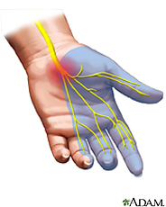
What is a sensor?
A sensor is a device that measures a physical quantity.
Example: When you touch an object, sensors on your fingers send signals to your brain so that it measures temperature, and so your brain recognizes the object as being hot or cold.
The skin in your fingers contains millions of sensitive nerve endings that can detect stimuli (physical quantities) such as temperature.
This stimulus is converted to neuronal impulses that are sent via nerves to a specific region in the brain, which interprets it as being hot or cold.
The same happens with pressure and pain signals.
Notes:
Sensing is all about measuring physical quantities and interpreting these measurements in order to draw conclusions.

Slide 6
What is a transducer?
A sensor is a device that senses or detects a signal. Signals are forms of energy, and a sensor senses a signal by typically converting one form of energy to another. This act of converting is also called transducing, and so sensors are also called transducers.
➔ So, a transducer is a device that converts one signal to another.
Examples: A microphone converts sound to electricity, a car speedometer converts wheel rotation to a speed reading. These signals are sent to the computer (or the brain).
➔ So, a sensor is also called a transducer.
Physics and engineering concepts are used to develop a variety of transducers, which you will learn about later. For instance, a type of pressure sensor converts strain (stretch) into an electrical signal.

Slide 7
Sensors provide information to make decisions: from stimulus to response
stimulus > sensor > coordinator > effector > response
touch > pain receptor > nervous system > muscle > movement
The sequence of steps above describes what happens when you touch something hot—the stimulus is touch, the sensor is the temperature receptor on your finger that senses it and relays it to the nervous system (spinal cord and brain), which is the coordinator. The coordinator makes the decision of how to react, and then commands the hand muscles (the effector) to jerk back quickly.
In summary: We go from stimulus (touch) to response (movement of hand).
Do This: Sketch out the stimulus-to-response sequence for how this might be implemented in a robot. Identify all the components, as in the example above. (Answers on slide 26)
Notes:
Sensing is all about measuring physical quantities and interpreting these measurements in order to draw conclusions.

Slide 8
Human Sensors
Your sensory organs (eyes, ears, nose and skin) provide information to your brain so that it can make decisions. They work in a manner similar to the working of robot sensors. Your brain continuously uses the information that it receives from your sensory organs to make your body function.
Five main human senses:
Your eyes allow you to see the world
Your ears allow you to hear sounds
Your skin lets you feel objects through touch
Your nose lets you smell the many scents in the world
Your tongue lets you taste
Plus additional sensors in our bodies that you do not notice directly:
Sensors in the inner ear give the brain information about balance
Sensors in muscles let the brain know body position
Sensors throughout the body that detect temperature
and others…

Slide 9
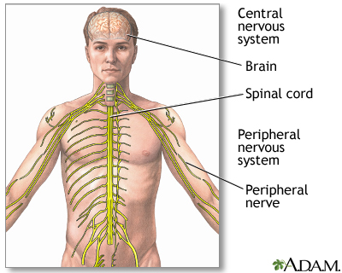
Human Sensors—Signal Transmission
When a human body sensors detect a stimulus, it sends this information through the nervous system (like wires) to the brain. The nervous system has two main parts:
The peripheral nervous system is a series of branches of single nerves that connect to every sensor in your body. They send signals to other nerves, which send signals to more nerves until the signal reaches the second part of the nervous system, the central nervous system.
The central nervous system consists of your spinal cord and your brain. The spinal cord is made of bundles of nerves that are surrounded by bones for protection. Once a signal from a sensor reaches the spinal cord, it is sent up the cord to the brain. The brain decides what to do based on the information received.

Slide 10
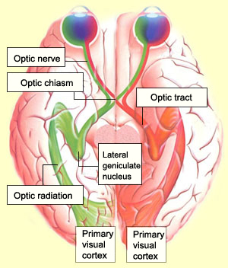
Vision: How does the brain understand what we see?
Light (stimulus) from the object enters the eye.
Light sensors convert (transduce) light into an electrical signal.
This electrical signal passes through the optic nerve to the lateral geniculate nucleus (LGN), which relays the information to the visual cortex.
The visual cortex processes this information and “recognizes” the object seen.

Slide 11
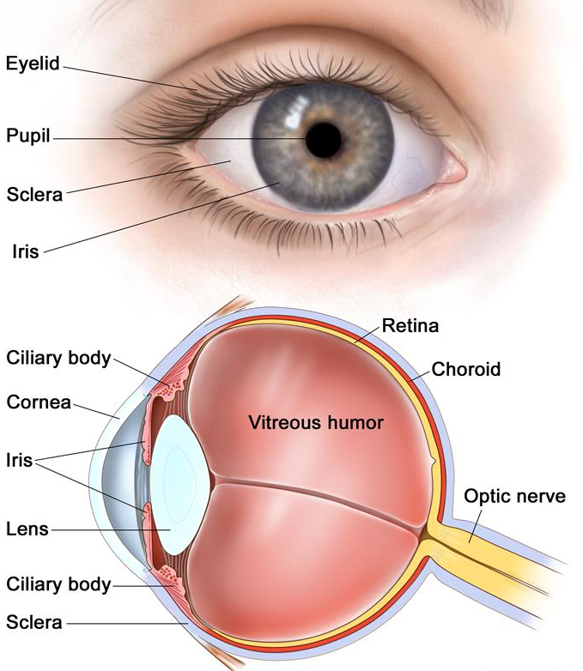
Vision: How do your eyes work?
Light enters the eye, and is refracted (bent) by the cornea, the outermost part of the eye.
Refracted light is directed to the pupil, a small hole in the center of the iris, the colored part of the eye. The iris changes the pupil size to allow more or less light to enter.
Light that goes through the pupil is redirected again by the eye’s lens, which points the light at nerve cells in the back of the eye.
Two types of nerve cells in the back of the eye:
Cones detect colors and fine details in good light.
They are concentrated in the center back of the eye.
Rods detect the presence of objects in poor light; they
are concentrated on the sides of the back part of the eye.
Cones and rods send signals through the optic nerve to the brain.
Do This: Brainstorm and write a stimulus-sensor-coordinator-effector-response pathway for this sensor. (Answers on slide 27)

Slide 12
Vision: How many light sensors do we have?
The cells in your eye that respond to light (that is, the sensors themselves) are called rods and cones.
Rods cannot distinguish colors, but are responsible for low-light black-and-white vision.
Cones are responsible for color vision.
Millions of rods and cones are present in each of your eyes, and they send their signals to the visual cortex of your brain.
The visual cortex integrates the signals from the rods and cones and assembles the “picture” of the object in your brain, similar to how a camera assembles the various bits of an object into a picture of the entire object.
* The rods and cones convert/transduce light energy into electrical energy, and send the energy along the optic nerve (similar to wires) to the visual cortex of your brain. *

Slide 13
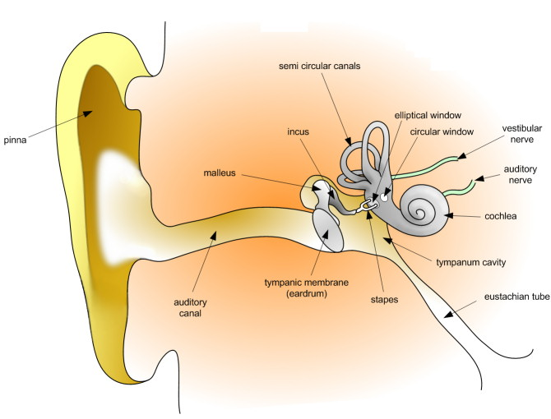
Sound: How do your ears work?
Sound waves enter the ear canal and cause the eardrum to vibrate.
Eardrum vibrations are carried through
the hammer, anvil and stirrup
of the ear to a fluid-filled structure
called the cochlea.
Different pitches cause different
parts of the fluid in the cochlea to vibrate.
When cochlear fluid vibrates, it moves hairs
connected to nerve cells, which send signals
to the brain through the auditory nerve.
The brain helps you recognize the sound.
Do This: Brainstorm and write a stimulus-sensor-coordinator-effector-response pathway for this sensor. (Answers on slide 28)

Slide 14
Sound: How many sensors do our ears have?
Thousands of neurons in your ears respond to sound.
These neurons respond differently to different pitches. Pitches range from low (such as from drums) to high (such as from bells). All these signals are sent individually to the auditory cortex in your brain.
The auditory cortex integrates all the frequencies correctly and helps your brain understand the sound (for example, music). This is similar to how a microphone assembles all the signals of sound and relays it forward.
* The neurons in your ear convert/transduce sound into electrical impulses, and send them along the auditory nerve (similar to wires) to the auditory cortex in your brain. *

Slide 15
What is sound?
Oscillation of air pressure is felt by humans as sound.
When air is pushed repeatedly, as by a speaker diaphragm, it creates what we call a sound wave.
Watch this video to learn more: (5 minutes) NASA “Science of Sound” http://www.youtube.com/watch?v=_ovMh2A3P5k

Slide 16
What is sound?
Sound is a mechanical wave:
Changes in air pressure (vibrations) produce the movement of air particles. These particles start bumping into the other air particles, and this causes a wave that travels in all directions.
Your ears can detect the wave (as shown in the video).
* The mechanical energy in the wave is sensed by our ears and converted to electrical energy, which is transmitted to the auditory cortex, and our brain recognizes this as sound. *

Slide 17
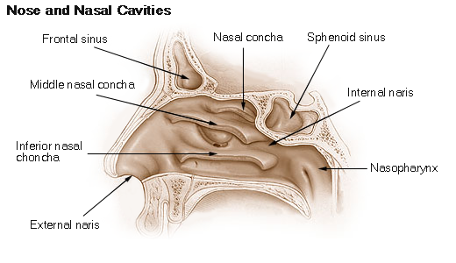
Smell: How do we smell using our noses?
Small particles of almost everything around us can be found in the air.
These particles enter the nose when you breathe in and contact nerve endings in the upper nasal passage.
The nerve endings send signals through the nervous system to the
Humans can distinguish between hundreds of different smells. Dogs can distinguish between thousands.
brain, which identifies the smell.
Watch this video on how smell works: (1:49 minutes)
http://videos.howstuffworks.com/howstuffworks/461-how-smell-works-video.htm
Do This: Brainstorm and write a stimulus-sensor-coordinator-effector-response pathway for this human sensor. (Answers on slide 29)

Slide 18
Smell: How many sensors do our noses have?
The roof of the nasal cavity has olfactory epithelium at the back. The olfactory epithelium (about the size of a quarter) contains special receptors that are sensitive to odor molecules that travel through the air.
These receptors/neurons are very small At least 10 million of them are in your nose!
These neurons respond differently to different odors, and the signals are sent via to the olfactory nerve to the olfactory bulb, which is in front of your brain, just above the nasal cavity.
Signals are sent from the olfactory bulb to other parts of the brain to be interpreted as a smell you may recognize. Humans can distinguish between 10,000 different smells!
Dogs have a much better sense of smell than humans. This is because they have 220 million smell receptors, and their olfactory epithelium is about the size of a saucer!
* The neurons in your nose convert/transduce the smell into electrical impulses, and send them along the olfactory nerve and olfactory bulb (similar to wires) to various parts of your brain. *

Slide 19
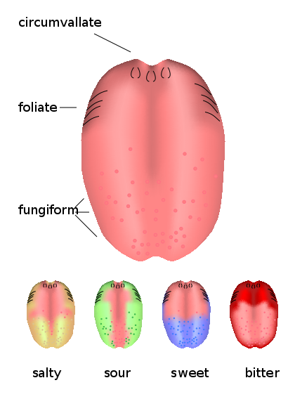
Taste: How do we taste using our tongues?
The tongue has sensory receptors called taste buds that detect 5 different flavors: sweet, salty, bitter, sour, umami
The umami flavor is present in many protein foods, such as meats, cheeses, tomatoes and mushrooms, and is generally described as a savory, meaty taste.
Taste buds are comprised of gustatory receptor cells that have tiny hairs that detect taste from the food you eat. The hairs send information to the cells, which send signals through the nervous system to the brain, which interprets the information as taste.
What is the difference between taste and flavor?
Flavor includes taste, but also a little more. It comprises taste, smell, texture and other sensations such as pain from spicy food. Eating food with your nose blocked shows decreases its flavor, even though the taste is the same.
Do This: Brainstorm and write a stimulus-sensor-coordinator-effector-response pathway for this sensor. (Answers on slide 30)

Slide 20
Taste: How many sensors do our tongues have?
Taste receptors are complicated, and scientists are continuing to investigate to completely understand our tongues.
We know that we can sense five different types of tastes—sweet, salty, bitter, sour and umami—but it is not clear how our tongue distinguishes between them.
It is believed that we have about 50 to 100 receptor cells per taste.
The olfactory bulb integrates inputs from all the receptor cells, and then sends the information to the brain.
* The receptors on a human tongue convert/transduce taste into electrical impulses, and send them along the olfactory nerve to the olfactory bulb and various parts of the brain. *

Slide 21
Taste Activity (20 minutes)
What is the difference between taste and flavor?
Remember that flavor includes taste, but also a little more. It is composed of taste, smell, texture and other sensations such as pain when you eat something spicy.
Eating food with your nose blocked shows a marked decrease in flavor, even though the taste is the same.
Let’s demonstrate this using a quick activity that uses some multi-flavored candies (such as Starburst) and working in pairs.

Slide 22
Taste Activity Steps
Mini-activity using Starburst (or other) flavored candies:
Divide the class into groups of 2 students each.
Give 1 student in each group 2 pieces of candy. Do not tell the other student in the group the flavors given.
Blindfold the partner without the candy and have him/her pinch his/her nose closed. This is the taster.
Have the other partner unwrap one piece of candy and give it to the blindfolded taster who chews the candy and guesses the flavor.
Then, the taster uses a dry paper towel to wipe his/her tongue dry, and again closes his/her eyes and pinches his/her nose. The partner gives the taster a second piece of candy and asks the taster to guess its flavor. Document the results of this test.
Switch roles and repeat the testing with two new candy pieces.
When testing is completed, discuss your findings as a class. What do you conclude from this experiment?
Notes:
Expect the activity to take a total of 20 minutes, including a class discussion to share student findings.
Expect students to realize that they are unable to correctly determine the candy flavors when their noses are blocked. This leads to the conclusion that sensory input from both tongue and nose are required to determine flavor.

Slide 23
What Is a Sensor? Post-Quiz
How do your nose (smell sensor) and skin (touch sensor) work as sensors? Provide details about the process in each case.
How many tastes can your tongue detect?
Why did most students have difficulty determining candy flavor when their noses were closed?

Slide 24
What Is a Sensor? Post-Quiz Answers
How do your nose (smell sensor) and skin (touch sensor) work as sensors? Provide details about the process in each case.
Particles are inhaled into the nose and nerve cells/receptors contact particles and send signals to the brain. About 10 million smell receptors are present in a nose.
Sensors all over the skin are activated and they send signals to the brain through the nervous system.
How many different types of taste can your tongue detect? List them.
Five: sweet, salty, bitter, sour and umami
Why did most students have difficulty determining the flavor of the candy when their noses were closed?
We use both our smell and taste sensors (nose and tongue) to identify flavors, and so if the nose is blocked, our brain does not get any signals from the nose, and thus makes incorrect judgments about the flavor.

Slide 25
Vocabulary
auditory: Related to hearing.
olfactory: Related to smell.
peripheral: Surrounding.
sensor: A device that converts one type of signal to another; for instance, the speedometer in a car collects physical data and calculates and displays the speed the car is moving.
stimulus: A thing or event that causes a reaction.
transducer: Another term for a sensor (see above).
ultrasonic: A sound of a frequency that humans cannot hear, but dogs and bats can.

Slide 26
Answer for Slide 7 Question
stimulus > sensor > coordinator > effector > response
object in front of robot > touch sensor > wires from touch sensor to brick > LEGO motor > robot moves back

Slide 27
Answer for Slide 11 Question
stimulus > sensor > coordinator > effector > response
bright light > cones in eyes > optic nerve and brain > muscle > pupil contracts

Slide 28
Answer for Slide 13 Question
stimulus > sensor > coordinator > effector > response
loud sound > ear > auditory nerve and brain > neck muscles > you move your head to see what caused it

Slide 29
Answer for Slide 17 Question
stimulus > sensor > coordinator > effector > response
pizza > nose > olfactory nerve and brain > salivary glands > you start salivating

Slide 30
Answer for Slide 19 Question
stimulus > sensor > coordinator > effector > response
candy > tongue > olfactory nerve and brain > mouth muscles > you say “tastes great!”

Slide 31
Image Sources
Slide 1: senses montage drawing; Microsoft® clipart: http://office.microsoft.com/en-us/images/results.aspx?qu=sense&ex=1#ai:MC900231880|
Slide 5: nerves in human hand; source: Adam, U.S. National Library of Medicine, National Institutes of Health: http://www.nlm.nih.gov/medlineplus/carpaltunnelsyndrome.html
Slide 9: human nervous system; source: Adam, U.S. National Library of Medicine, National Institutes of Health: http://www.nlm.nih.gov/medlineplus/ency/imagepages/8679.htm
Slide 10: pathway from eye to visual cortex; source: The Brain from Top to Bottom [copyleft] http://thebrain.mcgill.ca/flash/d/d_02/d_02_cr/d_02_cr_vis/d_02_cr_vis.html
Slide 11: human eye anatomy; source: National Cancer Institute, National Institutes of Health: http://www.cancer.gov/cancertopics/pdq/treatment/retinoblastoma/patient
Slide 13: human ear anatomy; source: 2006 Dan Pickard, Wikimedia Commons: http://commons.wikimedia.org/wiki/File:HumanEar.jpg
Slide 17: human nose anatomy; source: 2012 U.S. government via Wikimedia Commons: http://commons.wikimedia.org/wiki/File:Nose_and_nasal_cavities.png
Slide 19: taste buds on human tongue; source: 2008 Antimoni, Wikimedia Commons: http://commons.wikimedia.org/wiki/File:Kieli_kaikki_en.svg

