Slide 1
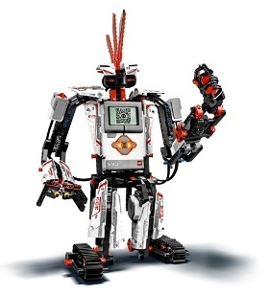
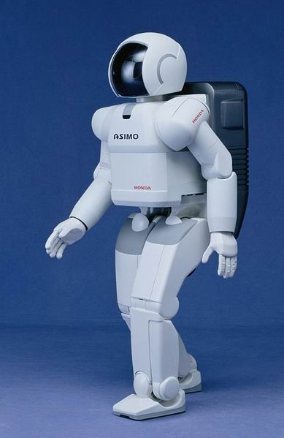
What is a Robot?
Image 1, Ref - see slide 17-18
A look at characteristics of robots using the LEGO EV3 as a specific example
(50 minutes)

Slide 2
PRE/POST-ASSESSMENT SHEET - What is a robot?
Describe in one sentence below what you understand by the term ‘robot’
2. What are the main parts of a robot?
What do people do to make a robot move?

Slide 3
PRE/POST-ASSESSMENT SHEET - What is a robot?
Describe in one sentence below what you understand by the term ‘robot’
A robot is a machine that gathers information about its environment (senses) and uses that information (thinks) to follow instructions to do work (acts).
2. What are the main parts of a robot?
Computer (to make decisions), Input ports (connected to sensors), and Outputs (connected to motors, for example).
What do people do to make a robot move?
They program it using software telling it precisely what to do, step by step.

Slide 4
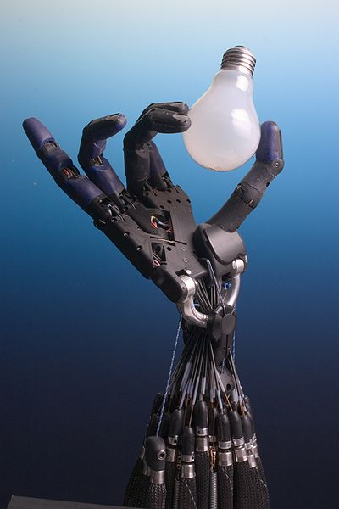
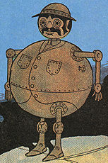
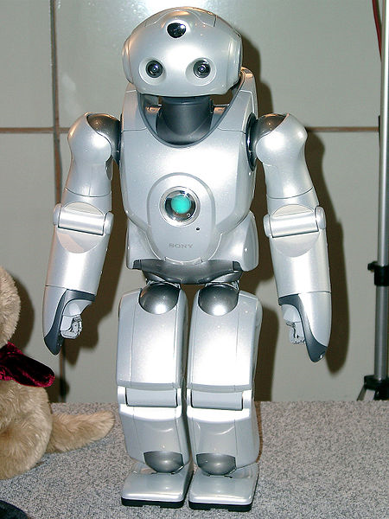
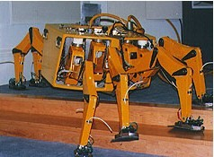
Robots in the World
We always think of Robots in movies
    Human Characteristics
      Learning
      Emotions
While there have been advances is Artificial Intelligence (AI)….
Image 2-5, Ref - see slide 17-18

Slide 5

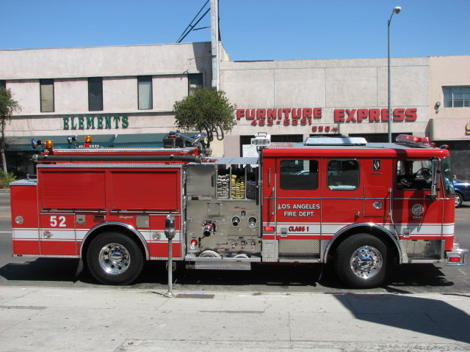

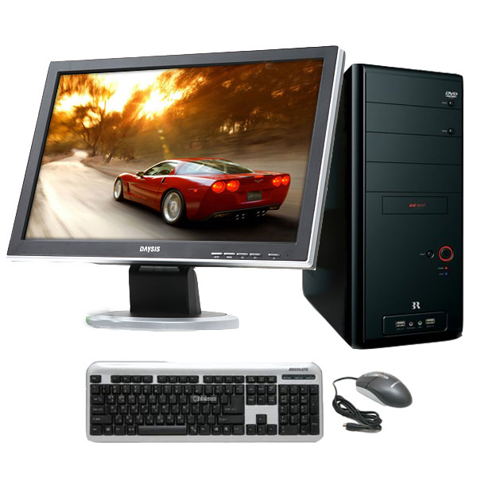
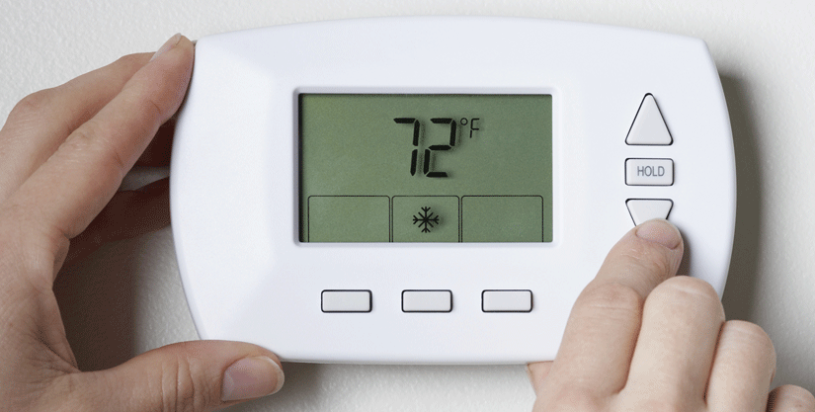
Robots in the World
…most robots look and act nothing like what we imagine in movies.
In fact, many everyday objects are robots, even though you may not have ever noticed.
This doesn’t mean that what they do is any less amazing!
Image 6-8, Ref - see slide 17-18

Slide 6
How do you define a robot?
Definition: “A robot is a machine that gathers information about its environment (senses) and uses that information (thinks) to follow instructions to do work (acts).”¹
Senses – using SENSORS; thinks – using COMPUTER; acts – using MOTORS, for example.
Engineers design robots to perform complex tasks more easily and with greater accuracy. Some everyday examples of robots include: automatic car washes, vending machines, automatic doors, robotic arms used in manufacturing, remote control cars and trucks, automatic teller machines (ATMs)
Can you name some devices that are robots?
…and some that are not?
¹The Tech Museum. “Robotics: Classroom Activities.” http://www.thetech.org/robotics/activities/index.html. 2005.

Slide 7
Some robot videos
LEGO® Robots
http://www.teachersdomain.org/resource/eng06.sci.engin.design.legorobot/
Engineering for the Red Planet
http://www.teachersdomain.org/resource/eng06.sci.engin.design.ayanna/
Anatomy of a Rover
http://www.teachersdomain.org/resource/eng06.sci.engin.design.rover/
Kismet
http://www.teachersdomain.org/resource/eng06.sci.engin.design.kismet/>
RoboSnail
http://www.teachersdomain.org/resource/eng06.sci.engin.systems.robosnail/
Robofly
http://www.teachersdomain.org/resource/eng06.sci.engin.systems.robofly/
Design Inspired by Nature
http://www.teachersdomain.org/resource/eng06.sci.engin.design.biomimicry/

Slide 8
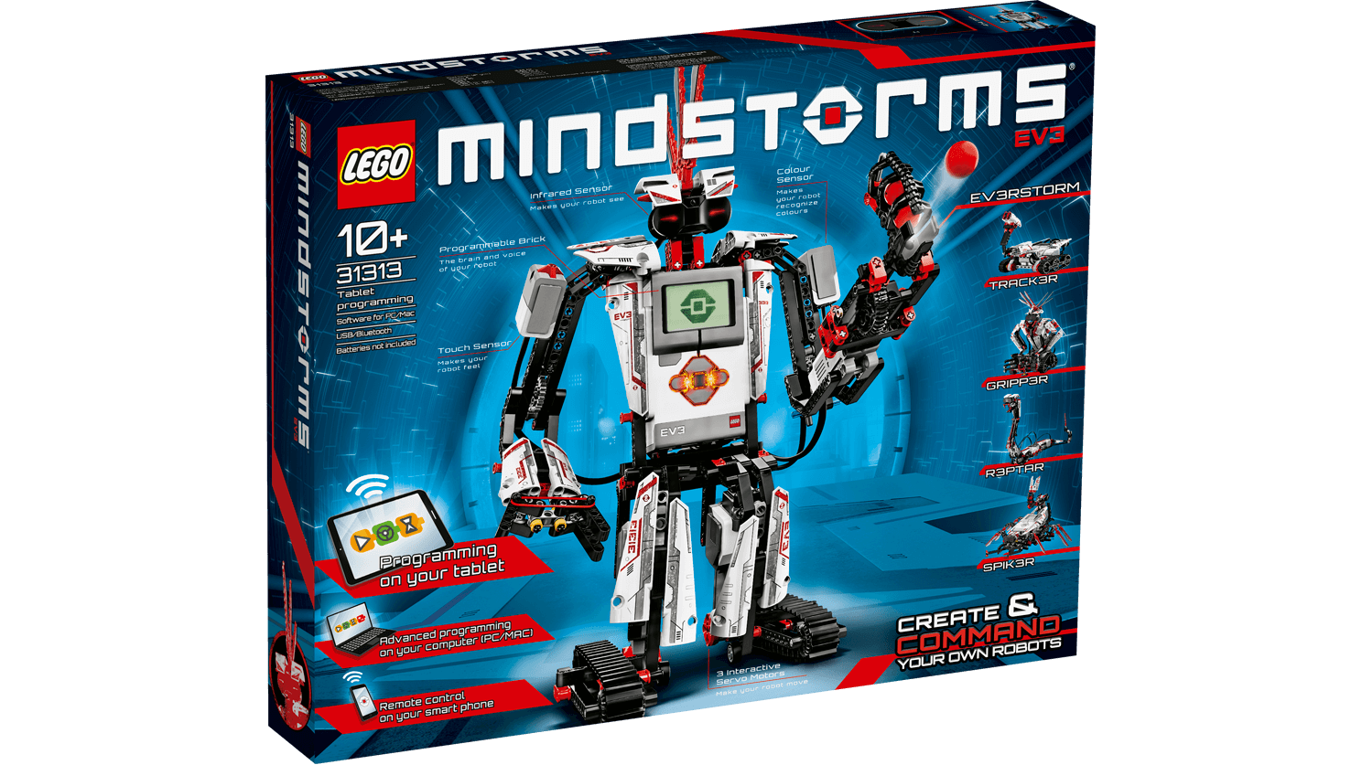
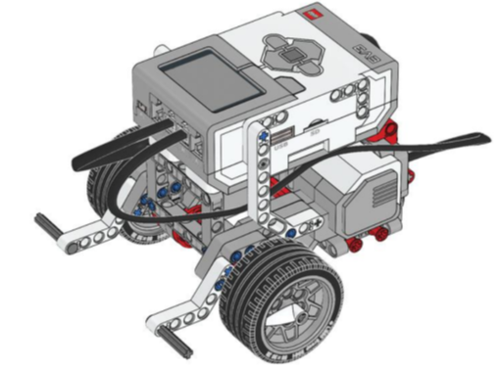
The EV3
The specific robot that we will be working with is the LEGO EV3.
The first robot you will make with the EV3 is called the “Robot Square”.

Slide 9
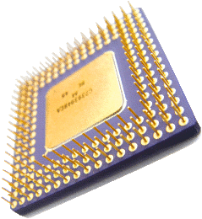

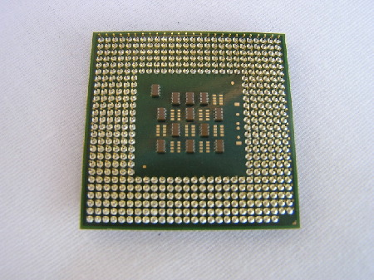
What Makes Something a Robot? #1:
A Computer (to help it ‘make decisions’)
There is one characteristic that ALL robots have:
  They are ALL controlled by a computer
    Not necessarily a computer like the one you have at home!
    Computers come in all shapes and sizes.
Believe it or not, these all are computers!

Slide 10
What Makes Something a Robot? #1:
A Computer (to help it ‘make decisions’)....Contd.
Since robots cannot think on their own like us, they have to follow specific instructions to make decisions.
These instructions are given to their computer in the form of a program.
The computer can then read the program and act like the robot’s brain, controlling the robot based on just running each instruction in the program in sequence.

Slide 11
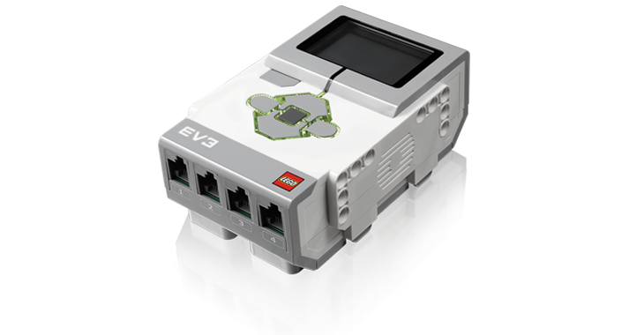
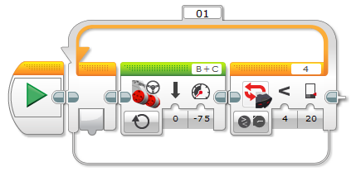
Computer of the EV3
The computer of the EV3 is called the EV3 computer brick.
We can program the EV3 using a programming software that LEGO provides with the EV3.

Slide 12

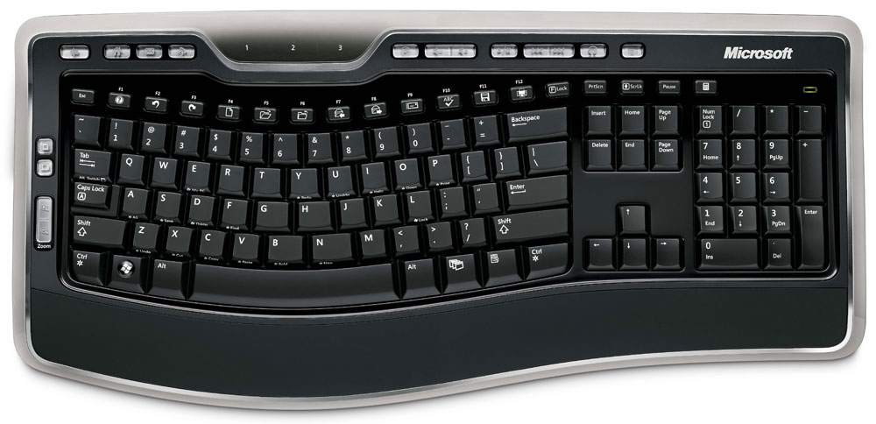
What Makes Something a Robot? #2: Inputs to ‘SENSE’ (via sensors)
Robots need inputs, which provide information to the its computer to make decisions.
  Think of it as a signal going “in” to the computer
Example
  The mouse and keyboard on your computer
  A camera on a robot that can act as its eye
Note: The important thing about inputs is that they have no effect if the program doesn’t tell the computer to look for them!

Slide 13
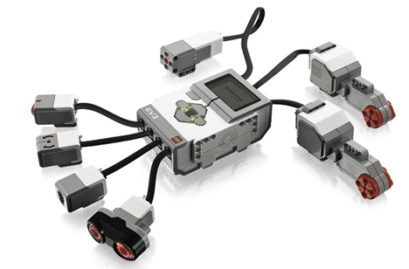
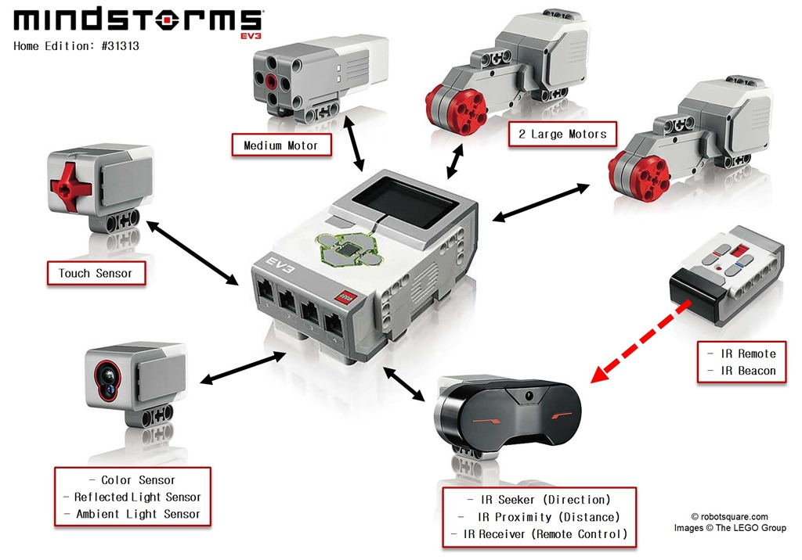
Inputs of the EV3: (sensors)
Four sensors come with the EV3
  Color sensor, touch sensor,
  Rotation sensor, ultrasonic sensor
The sensors are connected to the INPUT ports of the EV3 – 1, 2, 3, 4

Slide 14
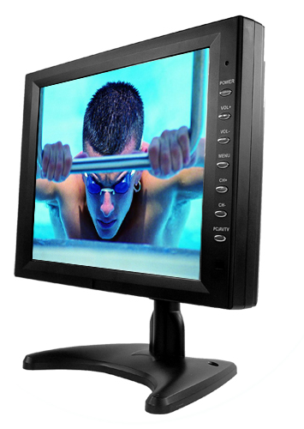
What Makes Something a Robot? #3: Outputs to ‘ACT’ (via motors, for example)
  An output is a command sent out by the robot computer to some other part of the robot
    You can think of it as a signal going “out” of the computer.
  Examples:
    Your computer monitor
      Your computer sends an image to your computer screen so that you can see what the computer is doing and use it easily.
    Motors on a robot
      The computer sends a signal to the motors of a robot to make it move.

Slide 15
Outputs of the EV3
The output ports are located at the top of the EV3 computer bricks. These ports don’t take in any information, they only send it out.
We can attach motors or lights to the output ports of the EV3 and then program the computer to activate them.

Slide 16
Summary
The parts of a robot are
  A computer that needs to be programmed (to make decisions)
  Inputs (to ‘sense’ via sensors)
  Outputs (to ‘act’, e.g., via motors)
Our EV3 has all three of these, and in the following activity, we’ll see how exactly we can put all these together and make the EV3 robot move based on your commands.

Slide 17
Image source/rights
Image 1: ADA Description: Asimov robot
Image file name: Robot_asimo_cropped.jpg
Source/Rights: http://commons.wikimedia.org/wiki/File:Robot_asimo_cropped.jpg
Image 2: ADA Description: Shadow hand bulb
Image file name: Shadow_Hand_Bulb_large_Alpha.png
Source/Rights: http://meta.wikimedia.org/wiki/File:Shadow_Hand_Bulb_large_Alpha.png
Image 3: ADA Description: Tiktok of Oz
Image file name: Tiktok.png
Source/Rights: http://meta.wikimedia.org/wiki/File:Tiktok.png
Image 4: ADA Description: Sony Orio robot
Image file name: Sony_Qrio_Robot.jpg
Source/Rights: http://meta.wikimedia.org/wiki/File:Sony_Qrio_Robot.jpg
Image 5: ADA Description: Robug
Image file name: Robug-3.jpeg
Source/Rights: http://meta.wikimedia.org/wiki/File:Robug-3.jpeg

Slide 18
Image source/rights
Image 6: ADA Description: Airplane
Image file name: Airplane_clipart.svg
Source/Rights: http://meta.wikimedia.org/wiki/File:Airplane_clipart.svg
Image 7: ADA Description: Truck
Image file name: OS_ANGELES_WESTERN_AVENUE_FIRE_DEPARTMENT_TRUCK_IMAGE_PATRICE_RAUNET_HOLLYWOOD.jpg
Source/Rights: http://meta.wikimedia.org/wiki/File:LOS_ANGELES_WESTERN_AVENUE_FIRE_DEPARTMENT_TRUCK_IMAGE_PATRICE_RAUNET_HOLLYWOOD.jpg
Image 8: ADA Description: TV
Image file name: TV-icon-2.svg
Source/Rights: http://meta.wikimedia.org/wiki/File:TV-icon-2.svg

