Slide 1
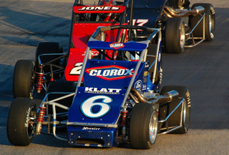
Cars: Engineering for Efficiency Day 1

Slide 2
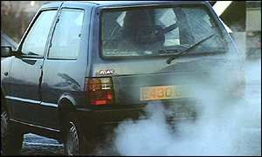
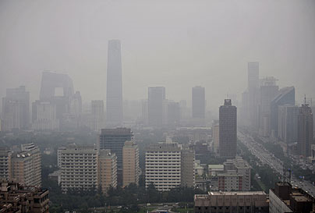
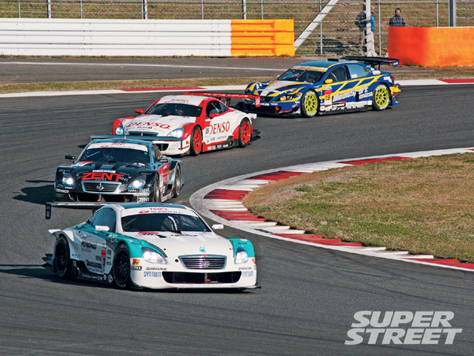
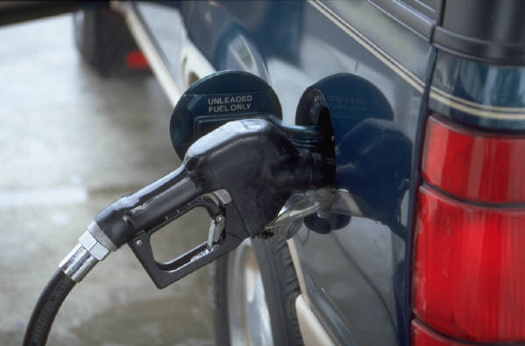
Why do engineers want to design energy-efficient cars?

Slide 3
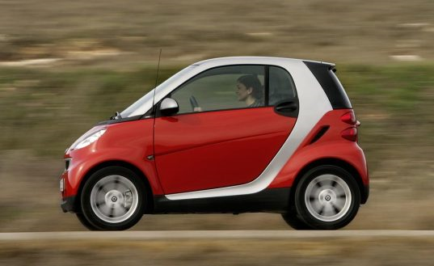
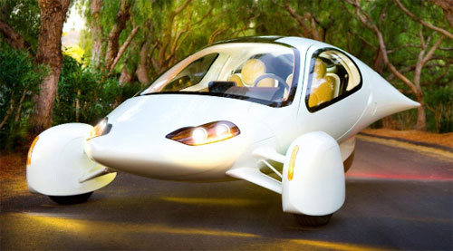
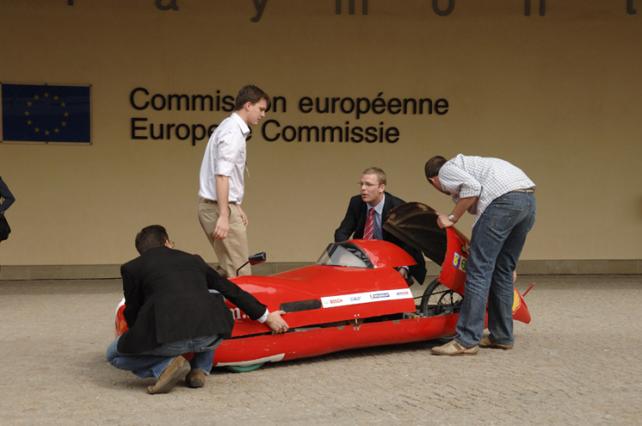
Energy-Efficient Cars
What are some special things you notice about these cars?

Slide 4
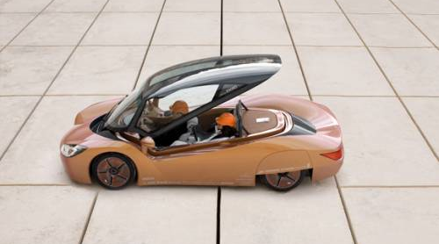
Efficient Cars…
Have a sleek design so they cut through the air smoothly.
Roll smoothly (Do not lose energy from friction in the wheels).
Have powerful and efficient motors or use renewable energy.
Are very small and light weight.

Slide 5
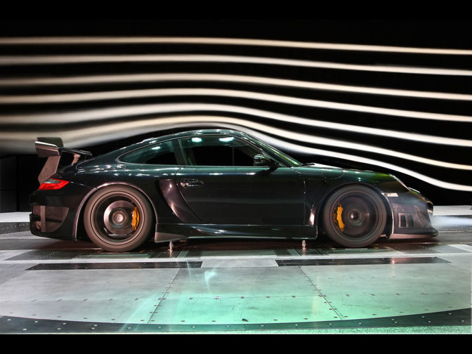
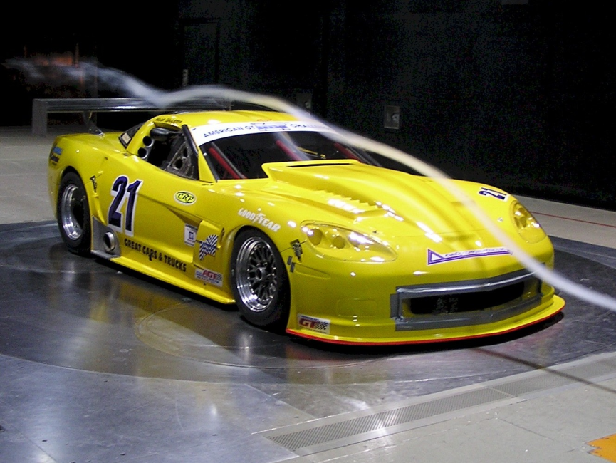
Aerodynamics
Air slows cars down a lot and makes them lose energy.
Cars were designed with smooth lines like fish to help them cut through the air.
Engineer’s test car designs in wind tunnels to see how easily they cut through the air.

Slide 6
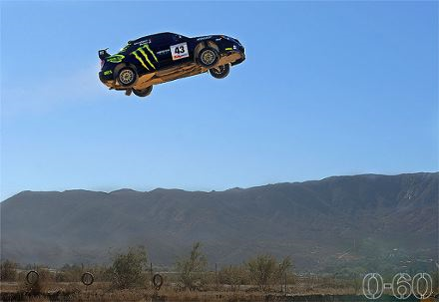
This Week's Project
Goal:
Design and build a car that will move the fastest (and maybe even jump the farthest)
Materials:
Lifesaver ® Mints, straws, tape, popsicle sticks, index cards, paper clips.
Test:
Ramp race track.

Slide 7
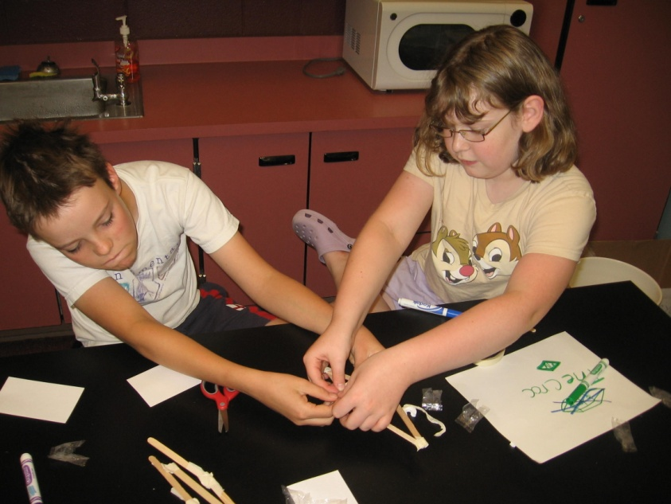
Engineering Design Process
Problem
Imagination
Design
Build
Test

Slide 8
Other Resources
Roller Coaster Design video (works similarly to the cars):
http://pbskids.org/designsquad/profiles/chris_gray.html

